Slide 1
Bioinformatics Analysis of DNA Methylation in Obesity using Publicly Available Data
Presented by Divya Ramesh G01447306 M.S. Bioinformatics and Computational Biology Dr. Jeff Solka School of Systems Biology George Mason University
1

Slide 2
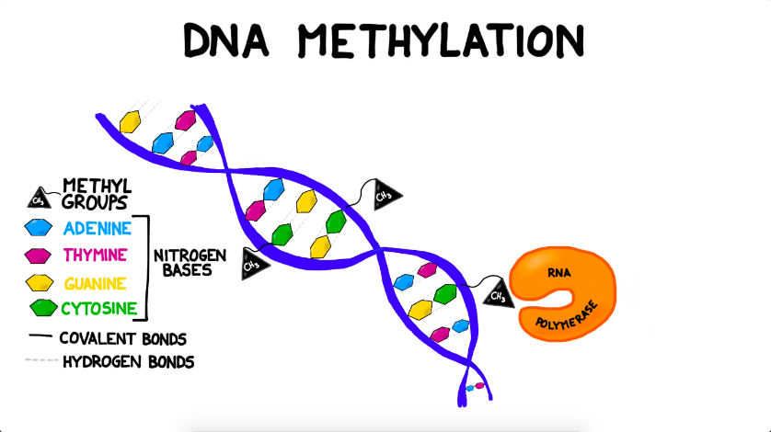
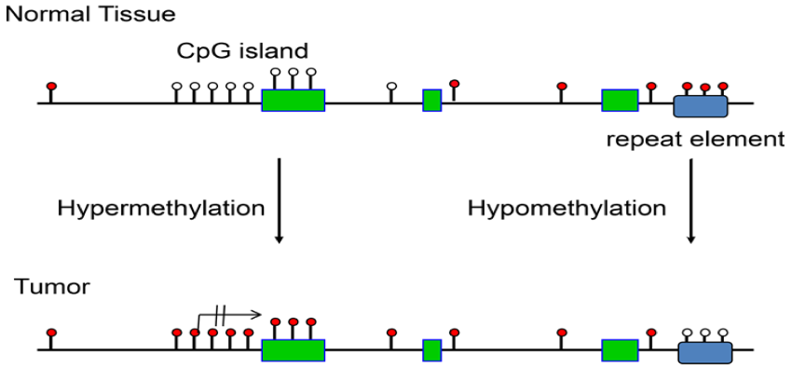
INTRODUCTION
DNA Methylation is an epigenetic mechanism which cells use to control or regulate gene expression by inhibiting the binding of transcription factors to DNA
It refers to the addition of a methyl (CH3) group to the DNA strand itself, often to the fifth carbon atom of a cytosine ring
A CpG island is defined as a 200-bp region of DNA with a GC content higher than 50%.
DNA Methylation in cancer - Abnormal methylation of DNA has been linked or related to a wide variety of diseases which includes cancer, obesity, cardiovascular diseases etc.
Cytosine
phosphate
Guanine
Figure 1: Mechanism of DNA Methylation (Ciechomska et al., 2019)
2

Slide 3
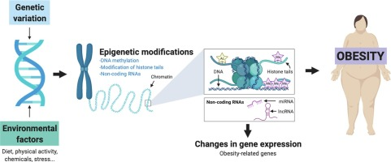
DNA Methylation in Obesity:
Obesity has been linked to lifestyle changes, which increases the risk of numerous diseases.
It is also linked to changes in DNA methylation, which in turn leads to abnormalities and contribute to various diseased states
Factors affecting DNA methylation in obesity:
Nutritional factors
Physiological factors
Figure 2: Epigenetic modifications in obesity (Samblas et al., 2019)
3

Slide 4
AIM:
To understand and explore the association of DNA methylation in the development of obesity
OBJECTIVES:
1. To obtain the differential methylation analysis of the publicly available dataset retrieved from GEO
2. To identify differentially expressed genes (DEGs) in the dataset
3. To perform pathway enrichment analysis for the genes obtained
4

Slide 5
TOOLS/SOFTWARE/PACKAGES USED
NCBI-GEO DATABASE
To extract the microarray datasets as well as original series and platform records in the Gene Expression Omnibus(GEO) repository.
R PACKAGES
METASCAPE
Within a series of orthogonal target-discovery research, Metascape delivers automated meta-analysis techniques to understand either common or unique pathways and protein networks
CHAMP - Used for the analysis of Illumina Methylation bead array data (EPIC and 450k) and to integrate currently available 450k and EPIC analysis methods
Limma - LIMMA stands for “linear models for microarray data”. It can be used for analyzing microarray and RNA-seq data
5

Slide 6
METHODOLOGY
The DNA methylation states of obese DNA specimens were obtained from GEO and the DNA methylation profiles were generated
An independent study was chosen based on the platform Infinium Human-Methylation450K BeadChip (Illumina)
The CHAMP package in R was used to integrate the 450K analysis methods and to perform differential methylation analysis
Limma was used for the analysis of gene expression microarray data and to identify differentially expressed genes (DEGs)
Pathway Enrichment Analysis was performed for the genes using the Metascape online software
6

Slide 7
DIFFERENTIAL METHYLATION ANALYSIS
1
Champ.load(dir)
Loading Data
CpG.Gui
2
mdsPlot
Champ.QC
Quality Check
QC.GUI
densityPlot
3
dendogram
Champ.norm
Normalization
4
Champ.runCombat
Batch Effect Correction
5
Champ.DMP
DMPs
DMP.GUI
6
Champ.DMR
DMRs
DMR.GUI
7

Slide 8
GEO DATASET
Table 1: DNA methylation studies chosen from GEO
Table 2: Number of Differential methylated probes in individual study
Accession ID | Number of samples | Title | Obese samples | Lean samples
GSE120062 | 38 | DNA Methylation data from frozen placental tissue | 29 | 9
GEO Study | Number of DE probes | Upregulated probes | Downregulated probes
Study 1 | 1377 | 1117 | 260
8

Slide 9
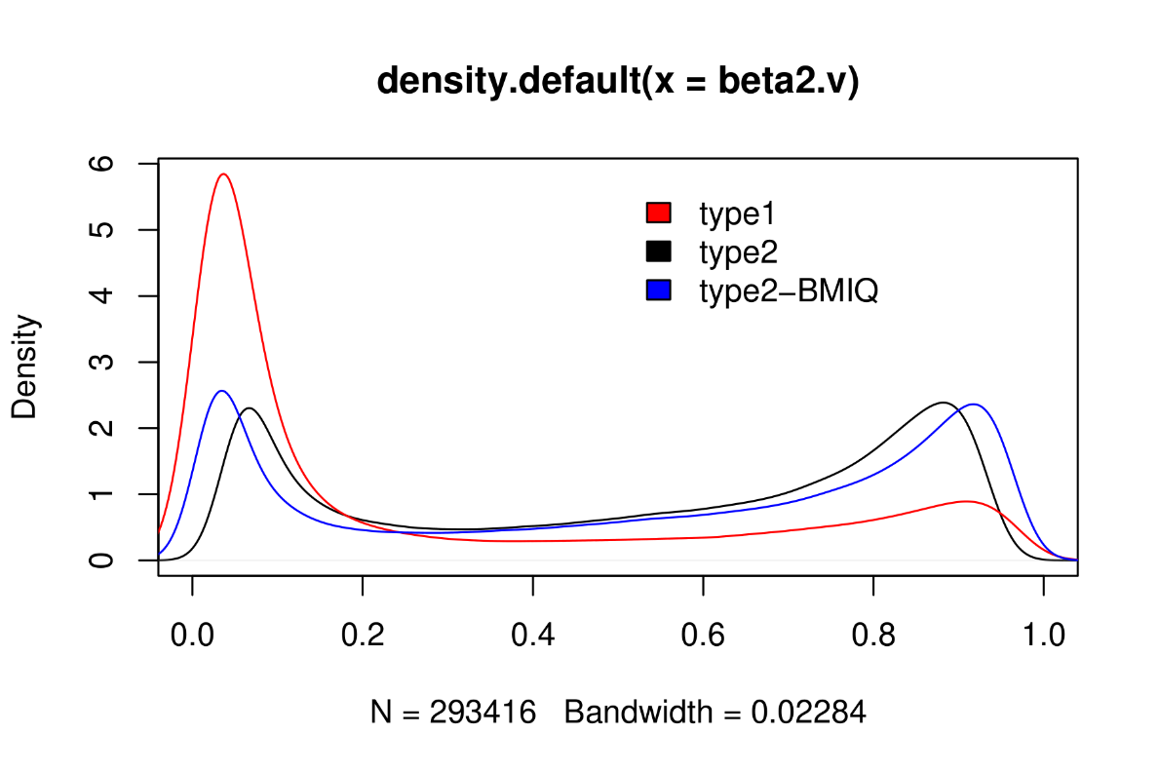
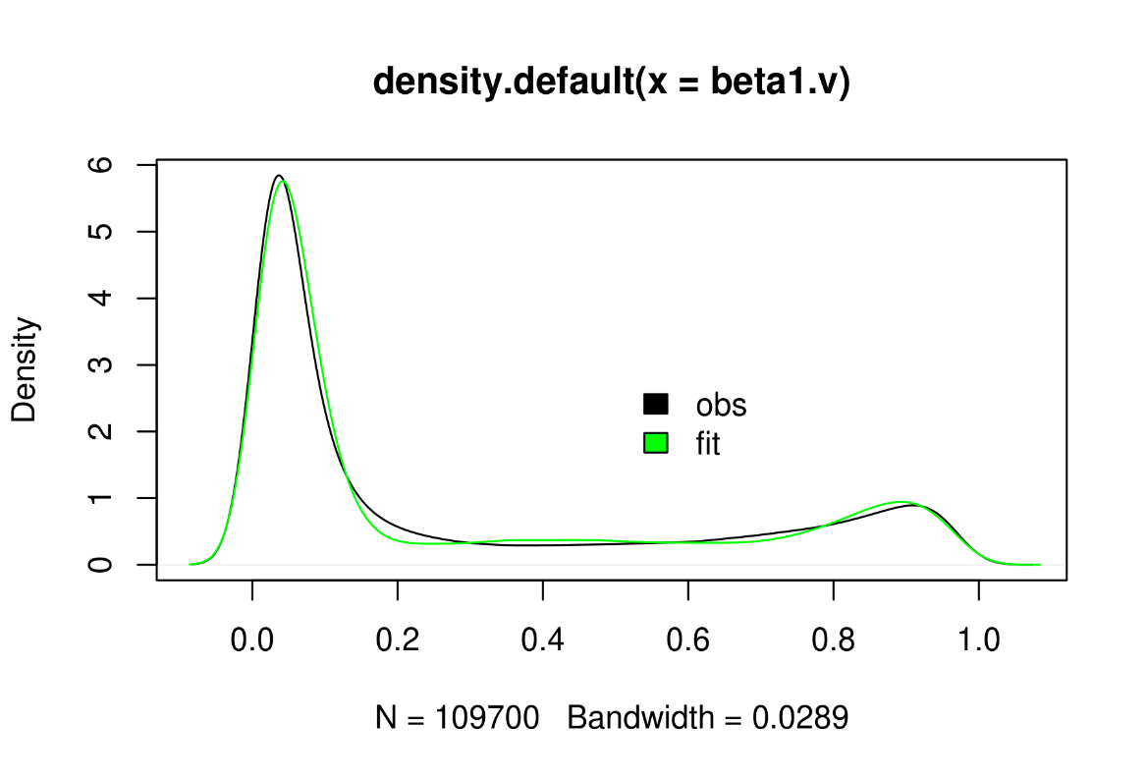
NORMALIZATION
Figure 3: Functional Normalization Plots

Slide 10
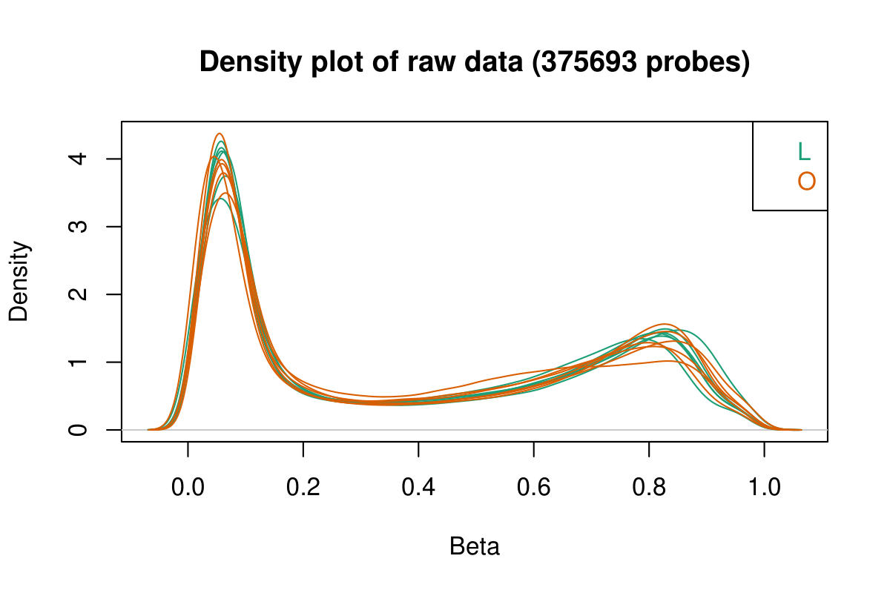
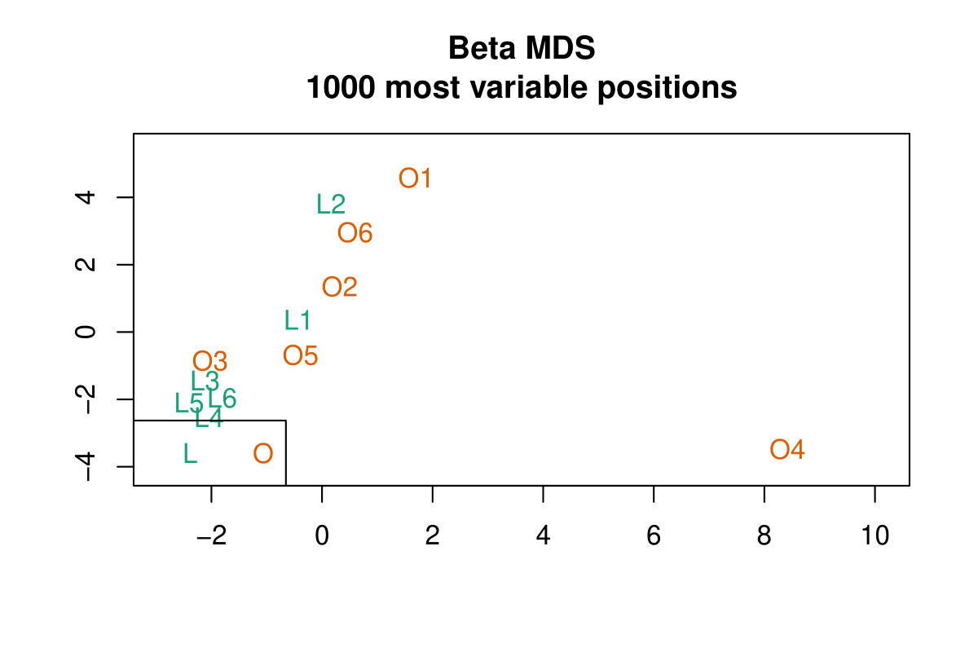
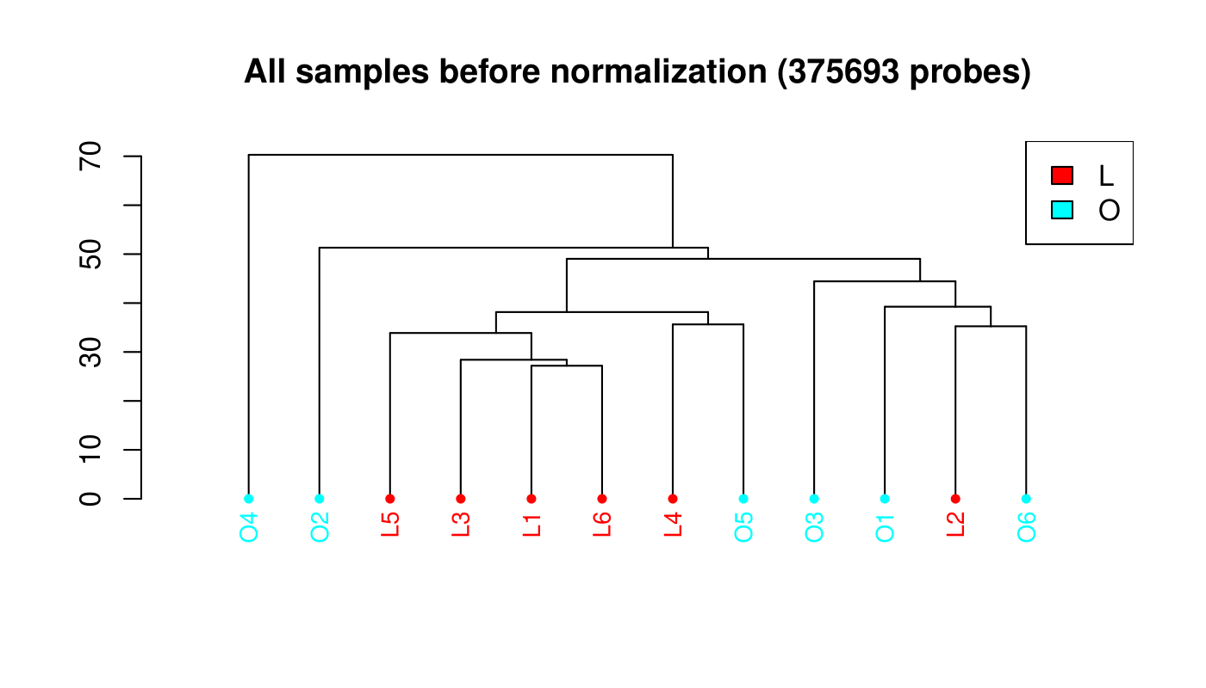
QUALITY
A.)
B.)
C.)
Figure 4: Quality Control and Exploratory Analysis Plot
A.) densityPlot
B.) mdsPlot
C.) dendogram
10

Slide 11
SVD PLOT
Figure 5: Singular Value Decomposition Plot
11

Slide 12
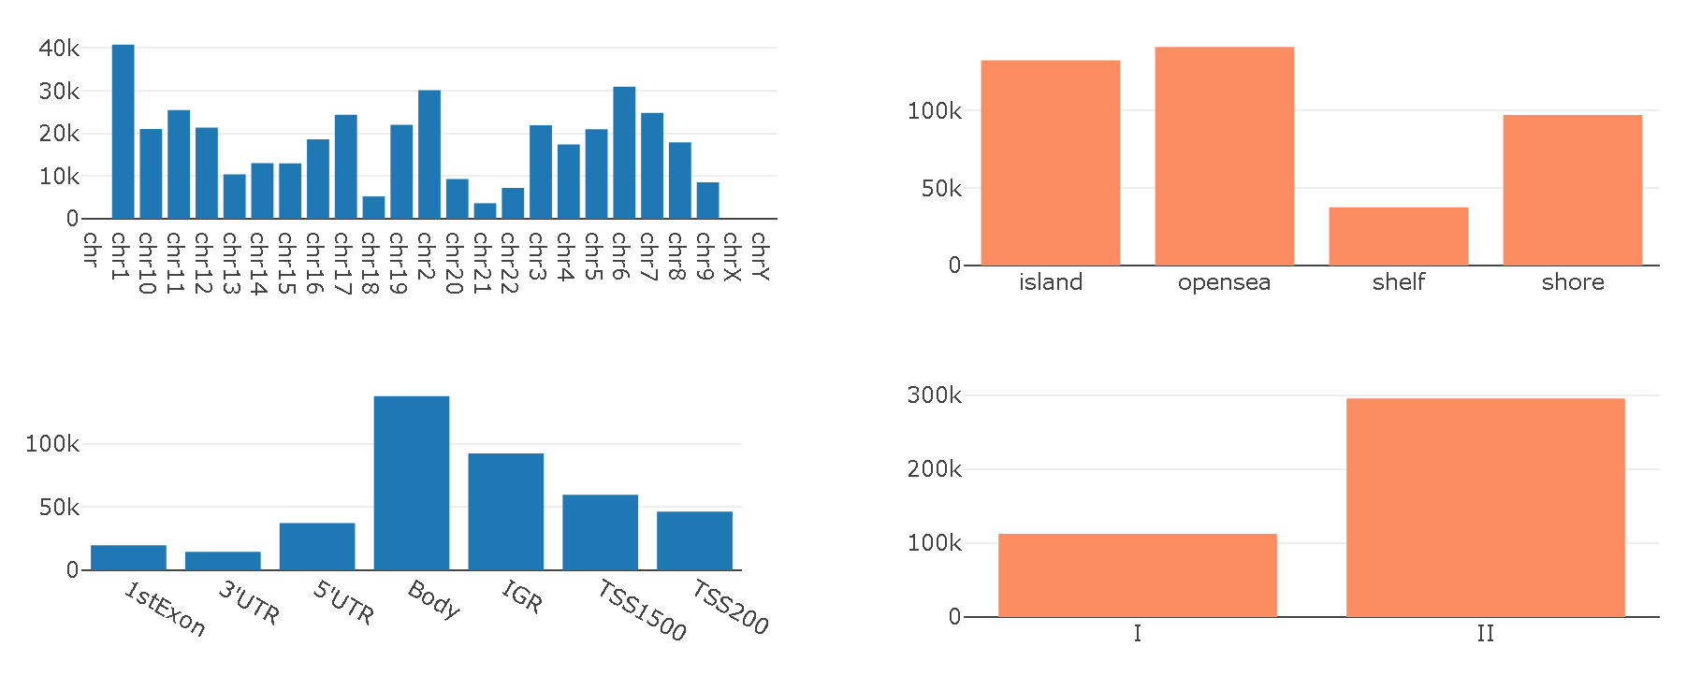
CPG RESULTS
Chr | Number
chr1 (Highest) | 40.805k
chr 21(Lowest) | 3638
Figure 6: Distribution of CpGs: Graphical interface of the distribution of CpGs in the Illumina 450K platform in different chromosomes and different regions of CpG islands.
12

Slide 13
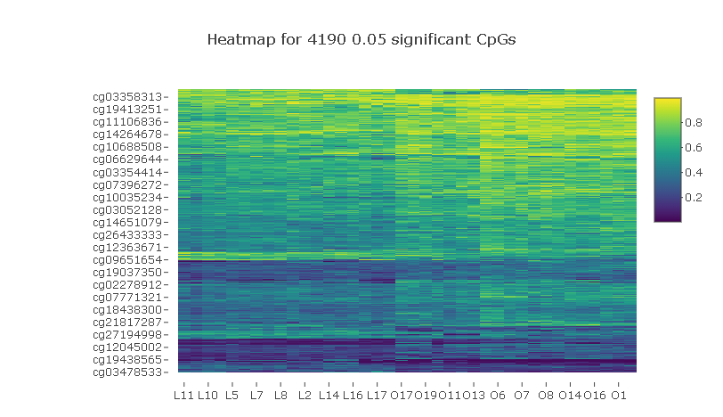
HEATMAP
Figure 4: Heatmap of all significant CpGs in individual study based on the number of obese and lean samples present
13

Slide 14
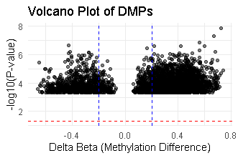
VOLCANO PLOT
Figure 7: Volcano Plot representing the distribution of delta methylation plots (DMPs)
14

Slide 15
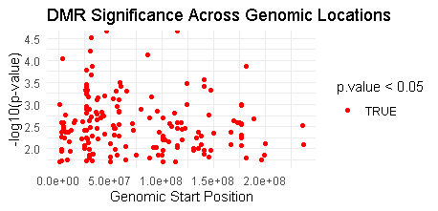
SCATTER PLOT
Figure 8: Scatter plot depicting the significance of DMRs across the genome
15

Slide 16
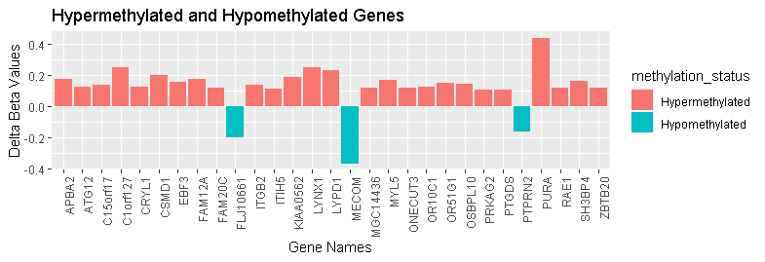
BAR CHART
Figure 9: Bar chart showing the delta beta values for hyper-methylated and hypo-methylated genes
16

Slide 17
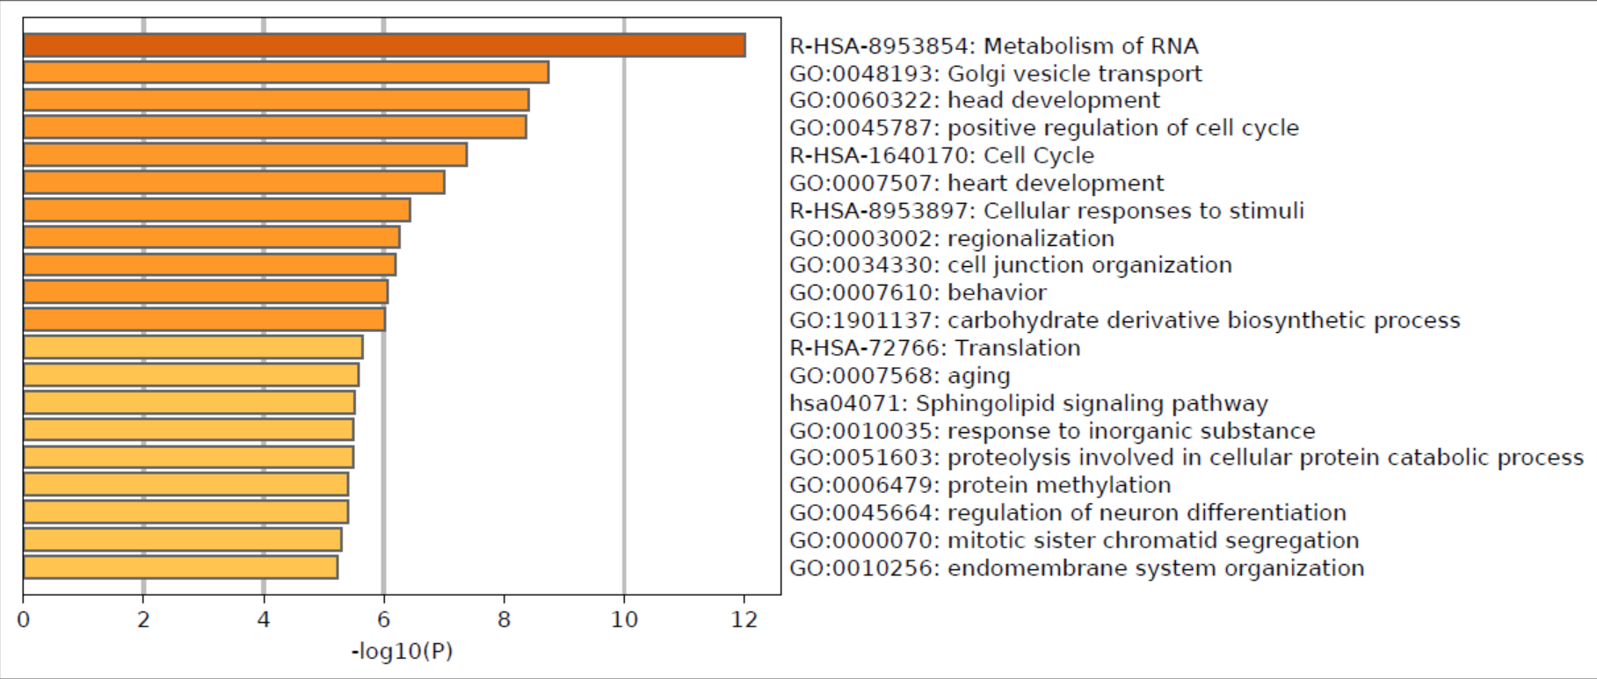
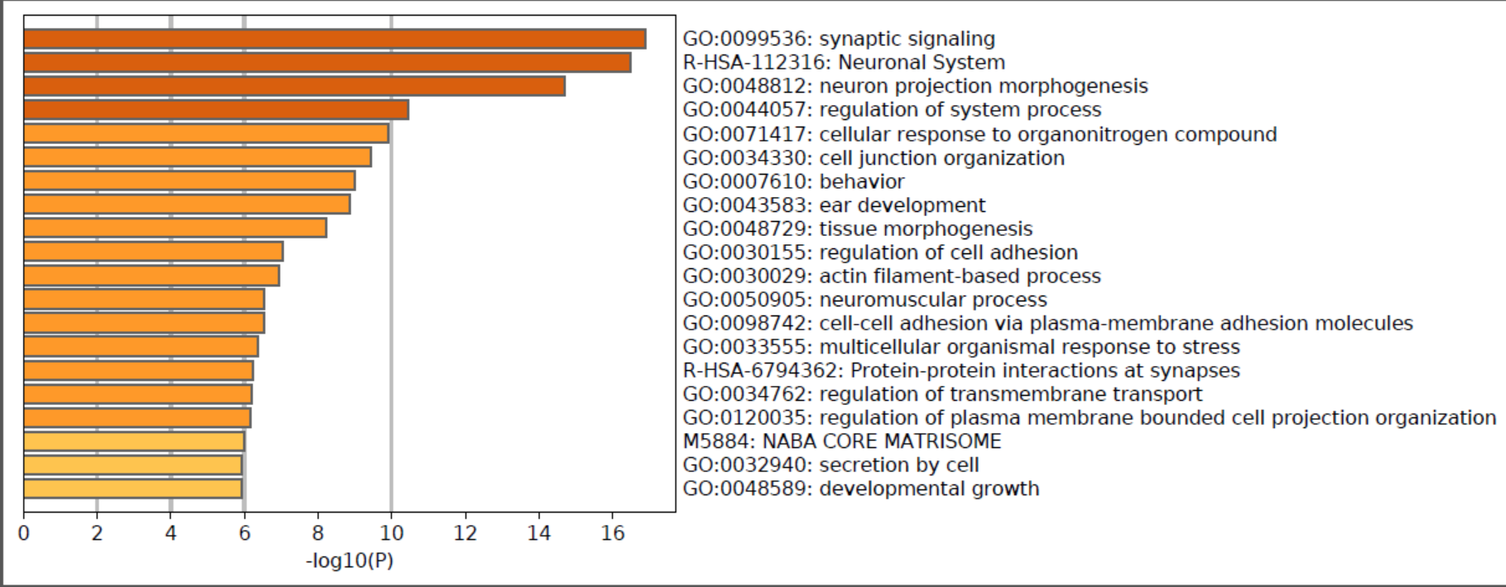
METASCAPE
A.)
B.)
Figure 10: A.) Biological processes involved in upregulated genes
B.) Biological processes involved in downregulated genes
17

Slide 18
DISCUSSION AND CONCLUSION
DNA methylation is an epigenetic alteration mechanism which helps in regulating or suppressing the expression of genes
Epigenetics has been related to the development of obesity since it is controlled by both genetic and environmental variables.
Array datasets from the Gene Expression Omnibus were used to investigate the DNA methylation statuses of obese DNA specimens (GEO).
A total of 38 samples were explored which included 29 lean and 9 obese people to see if there were any differences in methylation levels at the CpG region.
The Differential Methylation Analysis was performed for the three independent datasets retrieved and was found that 1117 probes were found to be upregulated and 260 probes were found to be downregulated.
This was further analyzed to obtain the pathway enrichment analysis and the biological processes involved in the DMGs that were obtained.
18

Slide 19
REFERENCES
Ciechomska, Marzena, Leszek Roszkowski, and Wlodzimierz Maslinski. 2019. “DNA Methylation as a Future Therapeutic and Diagnostic Target in Rheumatoid Arthritis.” Cells 8(9):1–16. doi: 10.3390/cells8090953.
Dong, L., Ma, L., Ma, G. H., & Ren, H. 2019. “Genome-Wide Analysis Reveals DNA Methylation Alterations in Obesity Associated with High Risk of Colorectal Cancer. Scientific Reports, 9(1), 5100. Https://Doi.Org/10.1038/S41598-019-41616-0.”
Elhamamsy A. R. 2017. “Role of DNA Methylation in Imprinting Disorders: An Updated Review. Journal of Assisted Reproduction and Genetics, 34(5), 549–562. Https://Doi.Org/10.1007/S10815-017-0895-5.”
Gallardo-Escribano, C., Buonaiuto, V., Ruiz-Moreno, M. I., Vargas-Candela, A., Vilches-Perez, A., Benitez-Porres, J., Romance-Garcia, A. R., Ruiz-Moreno, A., Gomez-Huelgas, R., & Bernal-Lopez, M. R. 2020. “Epigenetic Approach in Obesity: DNA Methylation in a Prepubertal Population Which Underwent a Lifestyle Modification. Clinical Epigenetics, 12(1), 144. Https://Doi.Org/10.1186/S13148-020-00935-0.”
Harrison, Alan, and Anne Parle-McDermott. 2011. “DNA Methylation: A Timeline of Methods and Applications.” Frontiers in Genetics 2(OCT). doi: 10.3389/fgene.2011.00074.
Lopomo, A., Burgio, E., & Migliore, L. 2016. “Epigenetics of Obesity. Progress in Molecular Biology and Translational Science, 140, 151–184. Https://Doi.Org/10.1016/Bs.Pmbts.2016.02.002.”
de Mello, V. D., Pulkkinen, L., Lalli, M., Kolehmainen, M., Pihlajamäki, J., & Uusitupa, M. 2014. “DNA Methylation in Obesity and Type 2 Diabetes. Annals of Medicine, 46(3), 103–113. Https://Doi.Org/10.3109/07853890.2013.857259.”
Moore, L. D., and Fan G. Le T. 2013. “DNA Methylation and Its Basic Function. Neuropsychopharmacology [Internet]. 2013 [Citado 2019 Apr 4]; 38: 23-38.”
Nicoletti, C.F., Pinhel, M.A.S., Noronha, N. Y. 2020. “Altered Pathways in Methylome and Transcriptome Longitudinal Analysis of Normal Weight and Bariatric Surgery Women. Sci Rep 10, 6515 Https://Doi.Org/10.1038/S41598-020-60814-9.”
19

Slide 20

THANK YOU
200

